Slide 1
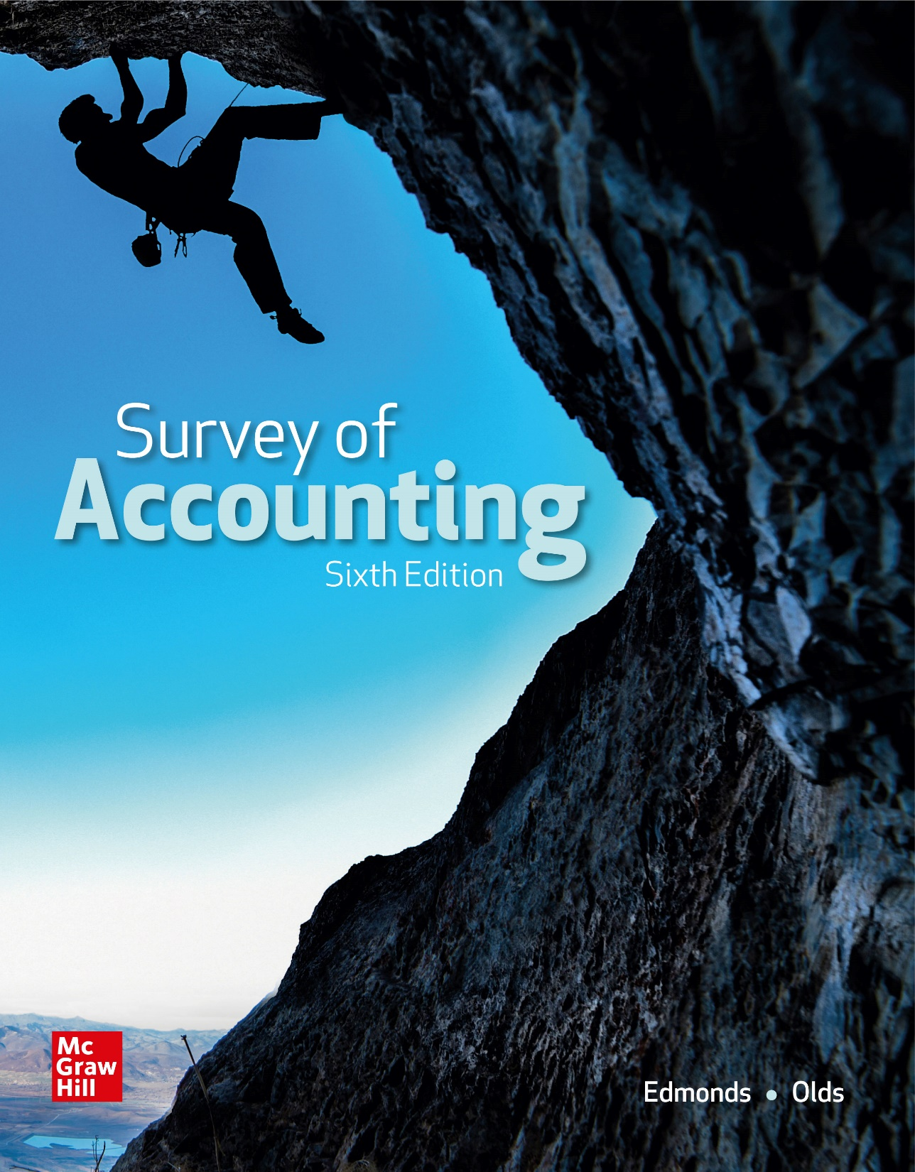
Chapter 6
Accounting for Long-Term Operational Assets

Slide 2
LO 6-1:
Identify and determine the cost of long-term operational assets.

Slide 3
Tangible versus Intangible Assets
Tangible assets have a physical presence; they can be seen and touched.
Intangible assets are rights or privileges. They cannot be seen or touched.

Slide 4
Tangible Long-Term Assets
Property, Plant, and Equipment — Sometimes called plant assets or fixed assets. The term used to recognize expense is depreciation.
Natural Resources — Mineral deposits, oil and gas reserves, timber stands, coal mines, and stone quarries are some examples of natural resources. The term used to recognize expense is depletion.
Land — Has an infinite life and is not subject to depreciation.

Slide 5
Intangible Assets
Intangible Assets with Identifiable Useful Lives — These intangibles include patents and copyrights. The term used when recognizing expense is amortization.
Intangible Assets with Indefinite Useful Lives — These intangibles include renewable franchises, trademarks, and goodwill. The cost of these assets is not expensed unless it can be shown that there has been an impairment in value.

Slide 6
Determining the Cost of Long-Term Assets
Buildings: (1) purchase price, (2) sales taxes, (3) title search and transfer document costs, (4) realtor’s and attorney’s fees, and (5) remodeling costs.
Land: (1) purchase price, (2) sales taxes, (3) title search and transfer document costs, (4) realtor’s and attorney’s fees, (5) costs for removal of old buildings, and (6) grading costs.
Equipment: (1) purchase price (less discounts), (2) sales taxes, (3) delivery costs, (4) installation costs, and (5) costs to adapt for intended use.

Slide 7
Basket Purchase
Acquiring a group of assets in a single transaction is known as a basket purchase. The total price of a basket purchase must be allocated among the assets acquired.
Accountants commonly allocate the purchase price using the relative fair market value method.

Slide 8
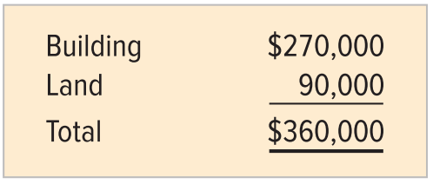
Basket Purchase Allocation
Beatty Company purchased land and a building for $240,000 cash. A real estate appraiser determined the fair market value of each asset to be as follows:

Slide 9
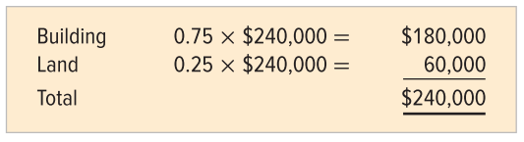
Basket Purchase Allocation
The appraisal indicates that the land is worth 25 percent ($90,000 ÷ $360,000) of the total value and the building is worth 75 percent ($270,000 ÷ $260,000). The actual purchase price is allocated as follows:

Slide 10
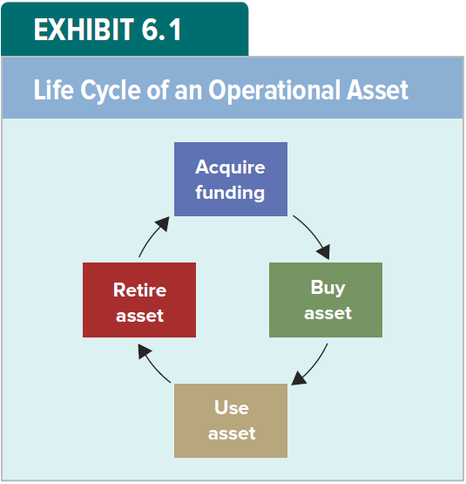
Life Cycle of an Operational Asset

Slide 11
Life Cycle of an Operational Asset
The life cycle of an operational asset involves (1) acquiring the funds to buy the asset, (2) purchasing the asset, (3) using the asset, and (4) retiring (disposing of) the asset.
This section describes the use of assets (Stage 3).
As they are used, assets suffer from wear and tear called depreciation.
Ultimately, assets depreciate to the point that they are no longer useful in the process of earning revenue.

Slide 12
Depreciation Expense, Salvage Value, and Depreciable Cost
The amount of an asset’s cost that is allocated to expense during an accounting period is called depreciation expense.
The expected market value of a fully depreciated asset is called its salvage value.
The total amount of depreciation a company recognizes for an asset, its depreciable cost, is the difference between its original cost and its salvage value.

Slide 13
Methods of Recognizing Depreciation Expense
Accountants must exercise judgment to estimate the amount of depreciation expense to recognize each period
The method used to recognize depreciation expense should match the asset’s usage pattern.
Three alternative methods for recognizing depreciation expense are:
Straight-line
Double-declining-balance
Units-of-production

Slide 14
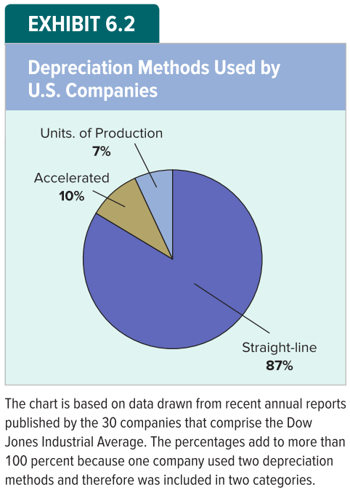
Relative Use of Depreciation Methods

Slide 15
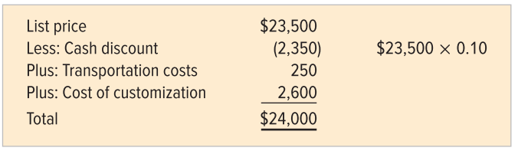
Illustration: Determining Cost of Long-Term Asset
Consider a van purchased by Dryden Enterprises. The van had a list price of $23,500. Dryden obtained a 10 percent cash discount. The van was delivered FOB shipping point, and Dryden paid $250 for transportation costs. Dryden also paid $2,600 for a custom accessory package.

Slide 16
LO 6-2:
Calculate straight-line depreciation and show how it affects financial statements.

Slide 17
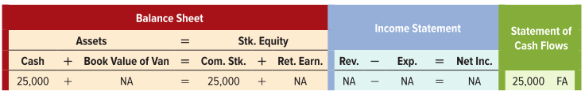
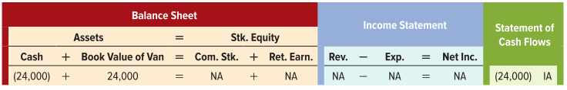
The Asset Life Cycle Illustrated
Dryden acquired $25,000 cash on January 1, Year 1, by issuing common stock.
Dryden bought the van on January 1, Year 1, using funds from the stock issue.

Slide 18
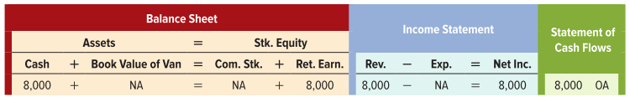
The Asset Life Cycle Illustrated
Dryden used the van by renting it to customers. The rent revenue each year is $8,000 cash.
This effects occurs four times – once for each year Dryden earns revenue by renting the van.

Slide 19
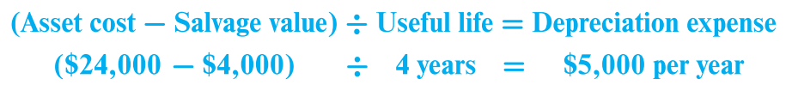
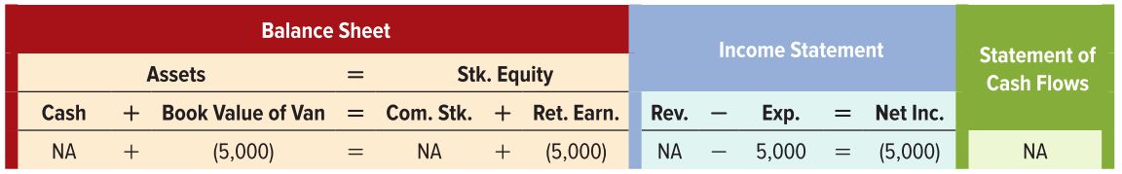
Straight-Line Depreciation
Depreciation expense calculated under straight-line is determined as follows:

Slide 20
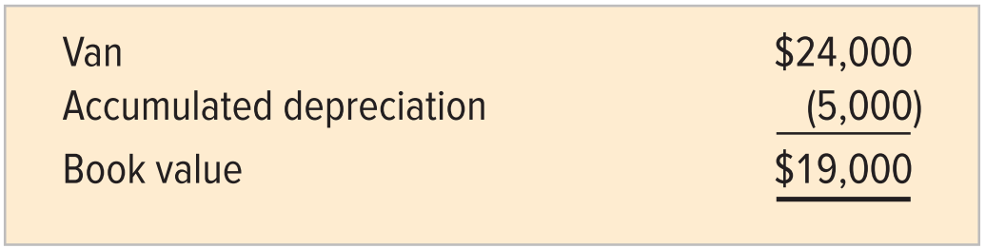
Book Value
The book value of a long-term tangible asset is determined by subtracting the balance in the Accumulated Depreciation account from the balance in the associated asset account. The book value may also be called the carrying value.
The book value of the van as of December 31, Year 1 is $19,000, computed as shown here:

Slide 21
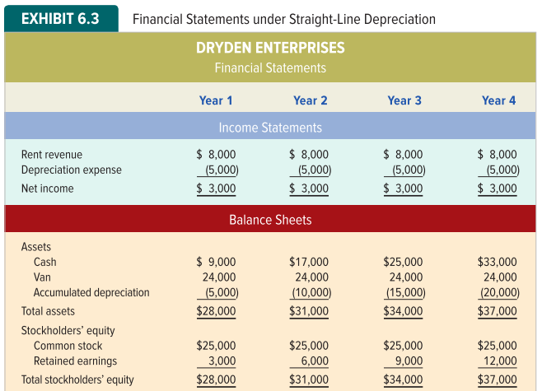
Financial Statements Under Straight-Line Depreciation

Slide 22
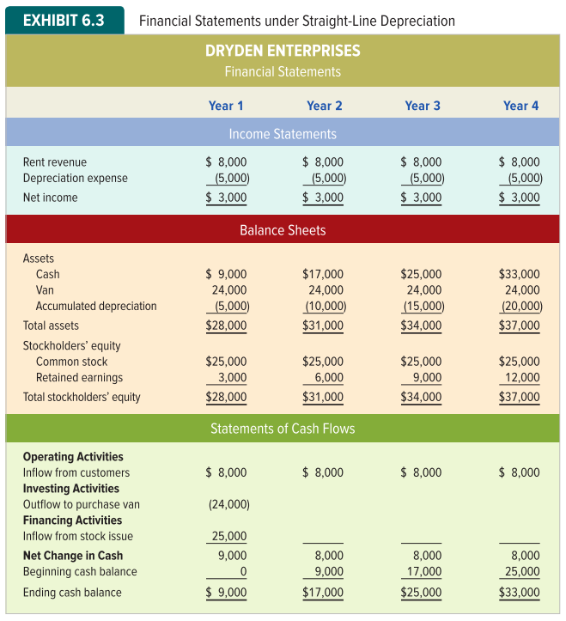
Financial Statements Under Straight-Line Depreciation

Slide 23
LO 6-3:
Calculate double-declining-balance depreciation and show how it affects financial statements.

Slide 24
Double-Declining-Balance Depreciation
Double-declining balance depreciation produces a large amount of depreciation in the first year of an asset’s life, and progressively smaller levels of expense in each succeeding year.
Since the double-declining balance method recognizes depreciation expense more rapidly than the straight-line method does, it is called an accelerated depreciation method.

Slide 25
Double-Declining-Balance Depreciation
Determining the amount of depreciation expense in any year is the result of a three-step process.
Determine the straight-line rate of depreciation. For Dryden, the straight-line rate is 25 percent (1 ÷ 4) per year.
Determine the double-declining-balance rate. Multiply the straight-line rate times two. The double-declining-balance rate for the van is 50 percent (25 percent x 2).
Determine the depreciation expense. Multiply the double-declining rate by the book value of the asset at the beginning of the period. (book value = cost minus accumulated depreciation.)

Slide 26
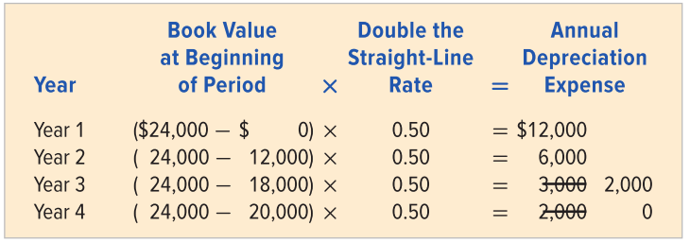
Double-Declining-Balance Depreciation Continued
Regardless of the depreciation method used, an asset cannot be depreciated below its salvage value. Dryden’s van had a historical cost of $24,000 and a salvage value of $4,000. The total amount of depreciable cost is $20,000. Since $18,000 is recognized in the first two years, only $2,000 remains to be recognized in Year 3.

Slide 27
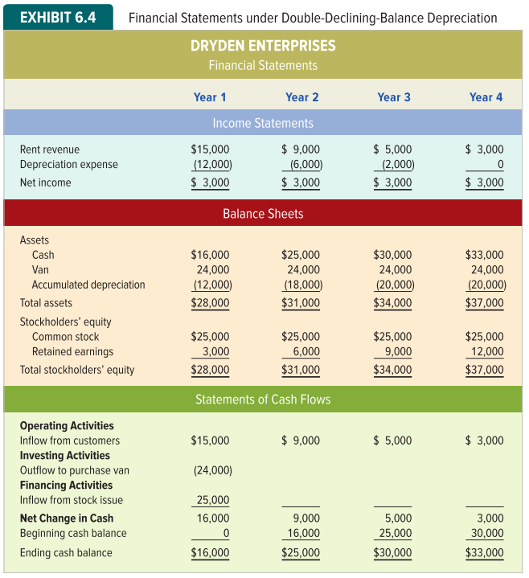
Financial Statements under Double-Declining-Balance Depreciation

Slide 28
Financial Statements under Double-Declining-Balance Depreciation

Slide 29
LO 6-4:
Calculate units-of-production depreciation and show how it affects financial statements.

Slide 30
Units-of-Production Depreciation
Suppose rental demand for Dryden’s van depends on economic conditions. In a robust economy, demand for renting vans is high. In a stagnant economy, demand for van rentals declines. Revenues fluctuate from year to year.
To accomplish the matching objective, depreciation should also fluctuate from year to year. Units-of-production depreciation accomplishes this goal.
Computing depreciation expense begins with identifying a measure of the asset’s productive capacity.

Slide 31
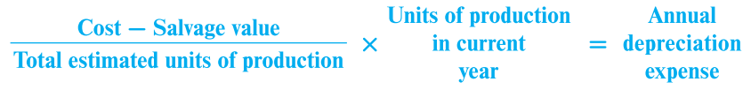
Units-of-Production Depreciation
Assume Dryden estimates the productive capacity of the van to be 100,000 miles. The first step is to compute the cost per unit of production. This amount is depreciable cost divided by total units of expected productive capacity. For Dryden’s van, the depreciation cost per mile is $0.20 [($24,000 cost - $4,000 salvage) ÷ 100,000 miles].

Slide 32
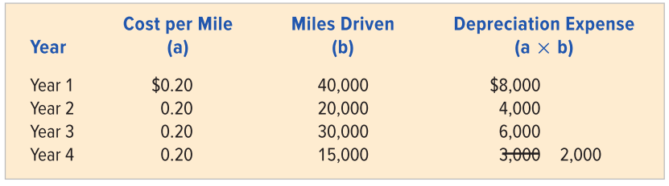
Units-of-Production Depreciation
An asset cannot be depreciated below its salvage value. Since $18,000 or the $20,000 depreciable cost is recognized in the first three years, only $2,000 remains to be charged to depreciation in the fourth year.

Slide 33
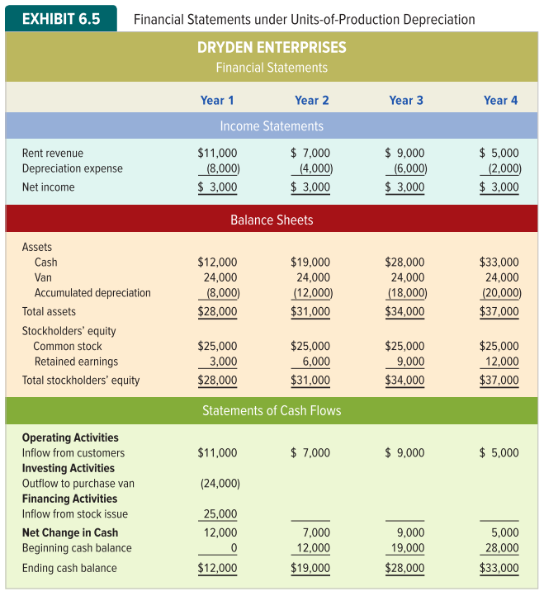
Financial Statements under Units-of-Production Depreciation

Slide 34
Financial Statements under Units-of-Production Depreciation

Slide 35
LO 6-5:
Show how gains and losses on disposals of long-term operational assets affect financial statements.

Slide 36
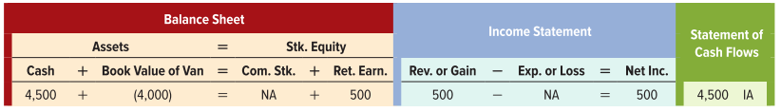
Accounting for the Disposal of Long-Term Operational Assets
Assume Dryden Enterprises retires the van from service and sells it on January 1, Year 5 for $4,500 cash. On this date, the van’s book value is $4,000 ($24,000 cost - $20,000 accumulated depreciation). Under these circumstances, Dryden would recognize a $500 gain ($4,500 sales price - $4,000 book value) on the sale.

Slide 37
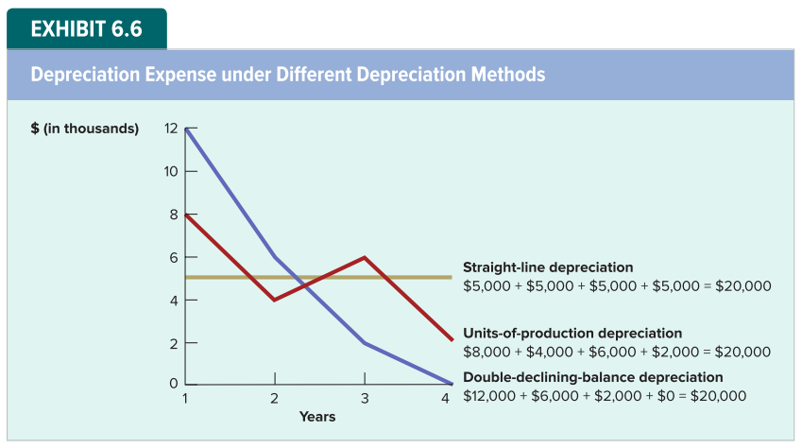
Comparing the Depreciation Methods

Slide 38
LO 6-6:
Show how revising estimates affects financial statements.

Slide 39
Revision of Estimates
Estimates are frequently revised when new information surfaces. Assume McGraw Company purchased a machine on January 1, Year 1, for $50,000. McGraw estimated the machine has an estimated useful life of 8 years, and a salvage value of $3,000. Using the straight-line method, the annual depreciation charge would be:

Slide 40
Revision of Life
At the beginning of the fifth year, accumulated depreciation on the machine is $23,500 ($5,875 × 4). The machine’s book value is $26,500 ($50,000 - $23,500).
Assume McGraw revises the expected life to 14, rather than 8, years. The machine’s remaining life would be 10 more years instead of 4 more years. Depreciation for each remaining year is:

Slide 41
Revision of Salvage
Alternatively, assume the original expected life remained 8 years, but McGraw revised its estimate of salvage value to $6,000. Depreciation for each of the remaining four years is:

Slide 42
LO 6-7:
Show how continuing expenditures for operational assets affect financial statements.

Slide 43
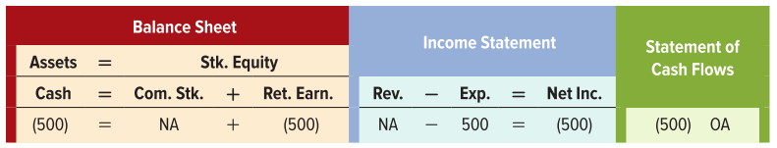
Costs That Are Expensed
Maintenance costs are the costs of routine maintenance and minor repairs that are incurred to keep an asset in good working order. These costs are expensed in the period in which they are incurred.
Assume McGraw spent $500 cash for routine lubrication and minor parts on machinery.

Slide 44
Costs that are Capitalized
Substantial amounts spent to improve the quality or extend the life of an asset are described as capital expenditures.
Capital expenditures are accounted for in one of two ways, depending on whether the cost incurred improves the quality or extends the life of the asset.

Slide 45
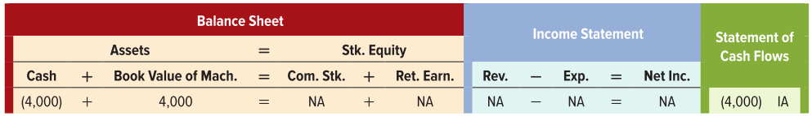
Improving Quality
If a capital expenditure improves an asset’s quality, the amount is added to the historical cost of the asset, which is expensed through higher depreciation charges over the asset’s remaining useful life.
Assume McGraw makes a major expenditure of $4,000 in the machine’s fifth year to improve its productive capacity.

Slide 46
Depreciation after Capitalizing Costs
The machine originally cost $50,000, had an estimated salvage value of $3,000 and a useful life of 8 years. The accumulated depreciation at the beginning of the fifth year is $23,500 ($5,875 x 4), so the book value is $26,500 ($50,000 - $23,500).
After recording the expenditure, the machine account balance is $54,000 and the asset’s book value is $30,500. The depreciation for each of the remaining 4 years is

Slide 47
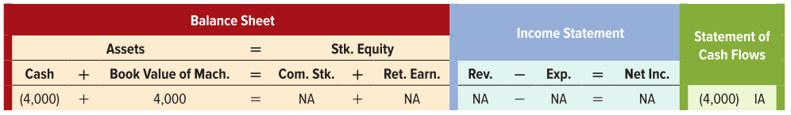
Extending Life
If a capital expenditure extends the life of an asset rather than improving the asset’s quality of service, accountants view the expenditure as canceling some of the depreciation previously charged to expense.
Assume McGraw’s $4,000 expenditure had extended the useful life of the machine by 2 years.

Slide 48
Depreciation after Extending Life
After the expenditure is recorded, the book value is the same as if the $4,000 had been added to the Machine account ($50,000 cost - $19,500 adjusted balance in Accumulated Depreciation = $30,500). Depreciation expense for each of the remaining 6 years follows:

Slide 49
LO 6-8:
Show how expense recognition for natural resources (depletion) affects financial statements.

Slide 50
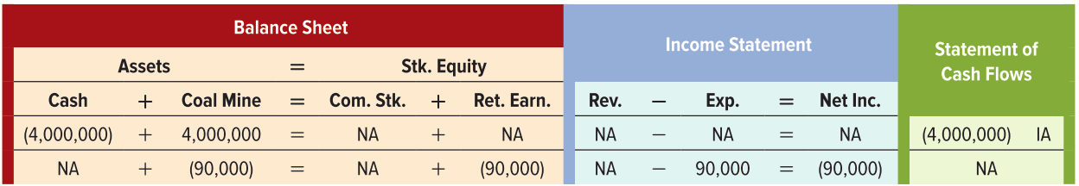
Natural Resources
Apex Coal Mining paid $4,000,000 cash to purchase a mine with an estimated 16,000,000 tons of coal. The unit depletion charge is:
If Apex mines 360,000 tons of coal in the first year, the depletion charge is:

Slide 51
LO 6-9:
Identify and determine the cost of intangible assets.

Slide 52
Trademarks and Patents
A trademark is a name or symbol that identifies a company or a product. The costs incurred to design, purchase or defend a trademark are capitalized in an asset account called Trademarks. Trademarks have an indefinite legal lifetime.
A patent grants its owner an exclusive legal right to produce and sell a product that has one or more unique features. The legal life of a patent is 20 years. The costs capitalized in the Patent account are usually limited to the purchase price and legal fees.

Slide 53
Copyrights and Franchises
A copyright protects writings, musical compositions, works of art, and other intellectual property. The protection extends for the life of the creator plus 70 years. The cost of a copyright is often expensed early because future royalties may be uncertain.
Franchises grant the exclusive right to sell products or perform services in certain geographic areas. The legal and useful lives of a franchise are frequently difficult to determine.

Slide 54

Goodwill
Goodwill is the value attributable to favorable factors such as reputation, location and superior products.
Calculating goodwill can be complex, here is a simple example. Suppose the accounting records of a restaurant named Bendigo’s show the following:

Slide 55
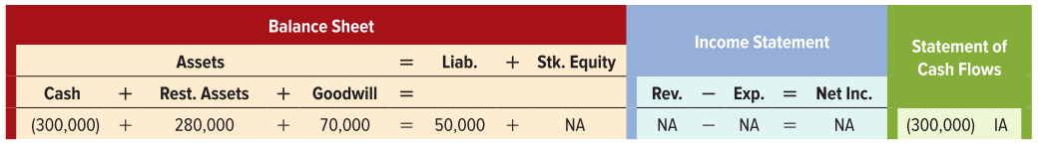
Goodwill
Assume a buyer agrees to purchase the restaurant by paying the owner $300,000 cash and assuming the existing liabilities (purchase price of $350,000).
The assets of the business have a fair market value of $280,000. Why would the buyer pay $350,000? The buyer is purchasing the business’s goodwill.

Slide 56
LO 6-10:
Show how the amortization of intangible assets affects financial statements.

Slide 57

Expensing Intangible Assets with Identifiable Useful Lives
An asset with an identifiable useful life is amortized using the straight-line method over the shorter of the intangible’s legal life or its useful life.
Assume that Flowers Industries purchased a newly granted patent that has a 20-year legal life but only an 11-year useful life for $44,000 cash.
Annual amortization expense = $44,000 ÷ 11 = $4,000

Slide 58
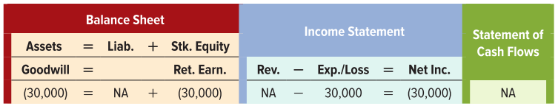
Impairment Losses for Intangible Assets with Indefinite Useful Lives
Intangible assets with indefinite useful lives must be tested for impairment annually. If the fair value of the intangible asset is less than its book value, an impairment loss is recognized.
Assume that the asset goodwill is determined to be impaired and the impairment loss to recognize is $30,000

Slide 59
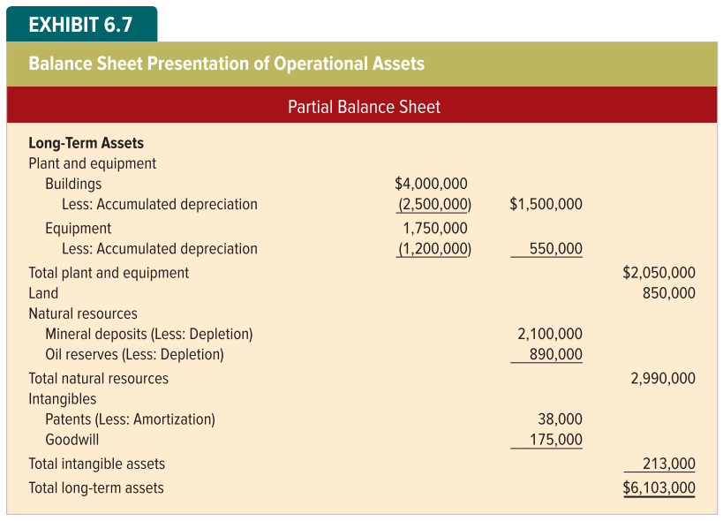
Balance Sheet Presentation

Slide 60
End of Chapter 6

